Slide 1
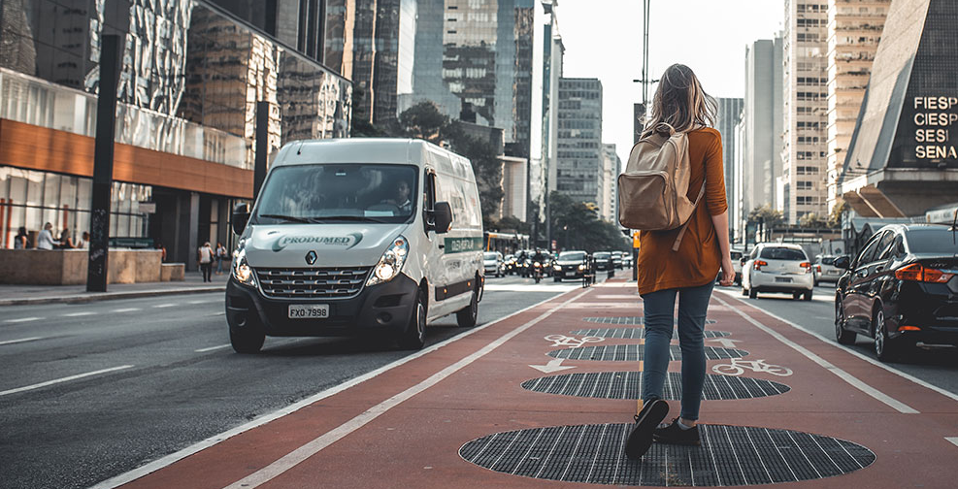
SUMADA

Slide 2

Battle of London Neighborhoods
Applied Data Science Capstone Project

Slide 3
Introduction
Migrating to new country poses great amount of uncertainty form type of neighborhood from safety point of view, availability of various amenities, facilities to easy access to public and private transportation
A local Immigration consulting firm, which assist Students and Immigrants relocate to various countries, seeking my expertise to assist their client to identify the best Borough/Neighborhood to settle down in London.
This project aims to select the safest borough in London based on the total crimes, explore the neighborhoods of that borough to find the 10 most common venues in each neighborhood and finally cluster the neighborhoods using k-mean clustering.

Slide 4
Data Acquisition
The data for this project is acquired from three sources :
The first data source of the project uses a London crime data that shows the crime per borough in London.
The second source of data is scraped from a Wikipedia page that contains the list of London boroughs. This page contains additional information about the boroughs.
The third data source is the list of Neighborhoods in the Royal Borough of Kingston upon Thames as found on the Wikipedia page.

Slide 5
Data Cleaning
The data cleaning process for each of the three sources of data are done separately.
From the London crime data, the crimes during the most recent year (2016) are only selected. The major categories of crime are pivoted to get the total crimes per the boroughs for each major category.
The second data extracted in tabular format, from a Wikipedia page using the Beautiful Soup library in python.
Above data is merged on the Borough names to form a new data set, to visualize the crime rates in each borough and identify the borough with the least crimes recorded during the year 2016.

Slide 6
…Data Cleaning
The third data set of Borough with lowest crime rate is created, with the names of the neighborhoods and the name of the borough with the latitude and longitude obtained using Google Maps API geocoding.
The third data set is used to generate the 10 most common venues for each neighborhood using the Foursquare API, finally using k - means clustering algorithm to cluster similar neighborhoods together.

Slide 7
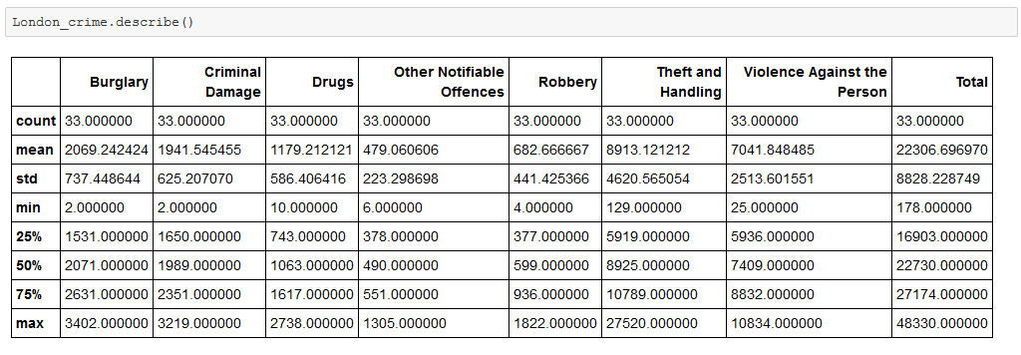
Exploratory Data Analysis
Methodology
Statistical summary of crimes
The count for each of the major categories of crime returns the value 33 which is the number of London boroughs. ‘Theft and Handling’ is the highest reported crime during the year 2016 followed by ‘Violence against the person’, ‘Criminal damage’. The lowest recorded crimes are ’Drugs’, ‘Robbery’ and ‘Other Notifiable offenses.

Slide 8
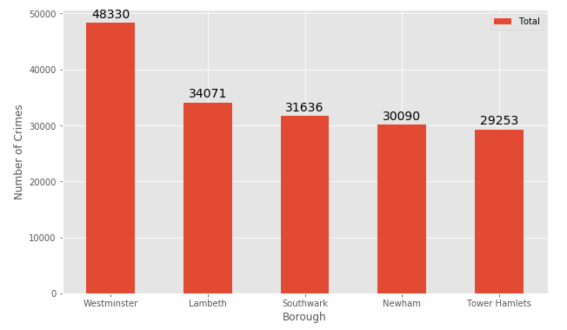
Exploratory Data Analysis
Methodology
Boroughs with the highest crime rates
Comparing five boroughs with the highest crime rate during the year 2016 it is evident that Westminster has the highest crimes recorded followed by Lambeth, Southwark, Newham and Tower Hamlets. Westminster has a significantly higher crime rate than the other 4 boroughs.

Slide 9
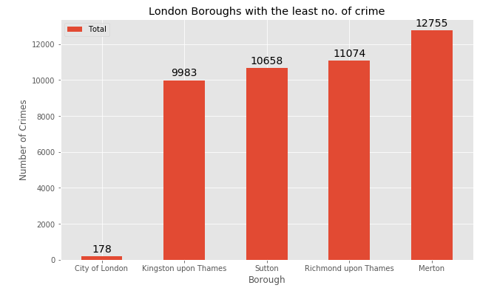
Exploratory Data Analysis
Methodology
Boroughs with the lowest crime rates
City of London has a significantly lower crime rate because it i is the 33rd principal division of Greater London but it is not a London borough. It has an area of 1.12 square miles and a population of 7000 as of 2013 which suggests that it is a small area. Hence, we will consider the next borough with the lowest crime rate as the safest borough in London which is Kingston upon Thames.

Slide 10
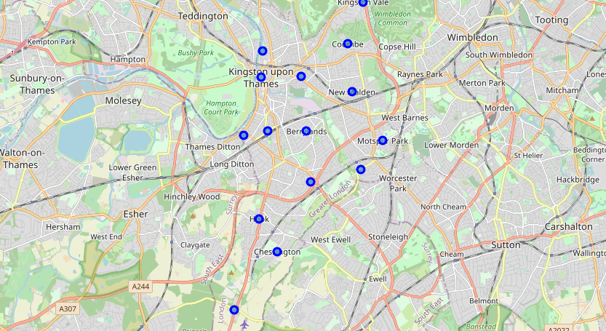
Exploratory Data Analysis
Methodology
Neighborhoods in Kingston upon Thames
There are 15 neighborhoods in the royal borough of Kingston upon Thames, they are visualized on a map using folium on python .

Slide 11
Modelling
Methodology
Using the final data set containing the neighborhoods in Kingston upon Thames along with the latitude and longitude, we can find all the venues within a 500 meter radius of each neighborhood by connecting to the Foursquare API.
One hot encoding is done on the venues data. The Venues data is then grouped by the Neighborhood and the mean of the venues are calculated, finally the 10 common venues are calculated for each of the neighborhoods.
To help people find similar neighborhoods in the safest borough we will be clustering similar neighborhoods using K - means clustering which is a form of unsupervised machine learning algorithm that clusters data based on predefined cluster size.
We will use a cluster size of 5 for this project that will cluster the 15 neighborhoods into 5 clusters. The reason to conduct a K- means clustering is to cluster neighborhoods with similar venues together so that people can shortlist the area of their interests based on the venues/amenities around each neighborhood.

Slide 12
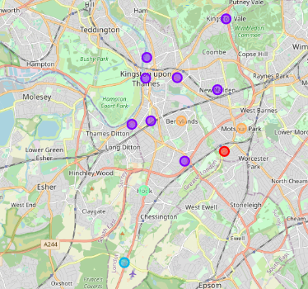
Result
After running K-means clustering, neighborhoods in Kingston upon Thames borough are grouped into five clusters. And are visualized using folium library.
Majority of the neighborhood falls in the Purple cluster which is the first cluster. Three neighborhoods have their own cluster (Green, Blue, Red and Yellow), these are clusters Four, Three, One and Five. The Yellow cluster consists of two neighborhoods which is the 5th cluster.

Slide 13
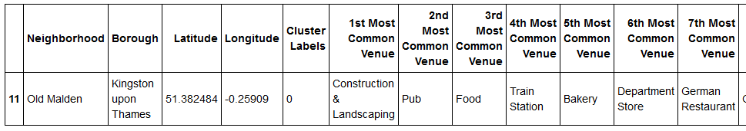
Cluster 1
Result
The First cluster has one neighborhood which consists of Venues such as Construction & Landscaping, Pub, Food add Train Station.

Slide 14
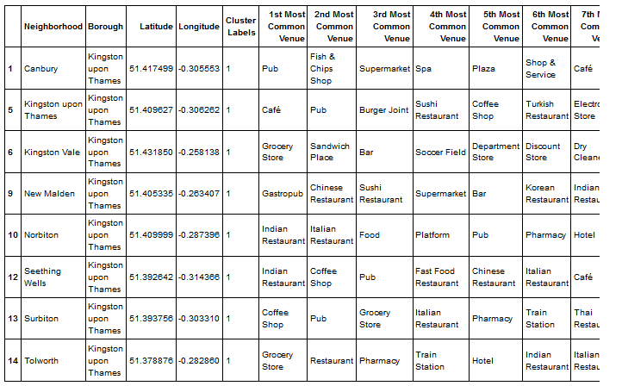
Cluster 2
Result
The Second cluster is the biggest cluster with 8 of the 15 neighborhoods in the borough Kingston upon Thames. Upon closely examining these neighborhoods we can see that the most common venues in these neighborhoods are Restaurants, Pubs, Cafe, Supermarkets, and stores.

Slide 15
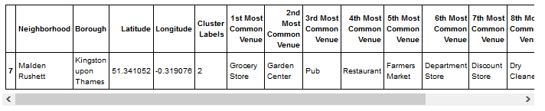
Cluster 3
Result
The third cluster has one neighborhood which consists of Venues such as Grocery Store, Garden Center, Pub, Restaurants, Farmers Market etc.

Slide 16
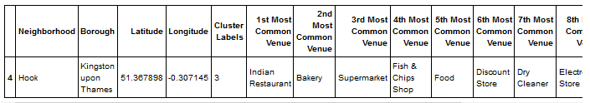
Cluster 4
Result
The fourth cluster has one neighborhood in it, and is famous for Indian Restaurant, bakery, Supermarket, Discount Store, Dry Cleaner and Farmers Market etc.

Slide 17
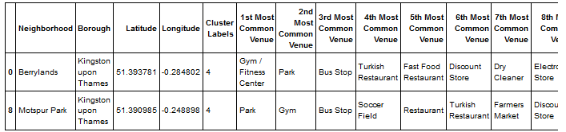
Cluster 5
Result
The fifth cluster has two neighborhoods in it, these neighborhoods have common venues such as Parks, Gym/Fitness centers, Bus Stops, Restaurants, Electronics Stores and Soccer fields etc

Slide 18
Discussion
If a person is looking for a neighborhood with good connectivity and public transportation, we can see that Clusters 1, 5 and few neighborhoods in 2 have Train stations and Bus stops as the most common venues.
If a person is looking for a neighborhood with stores and restaurants in a proximity, then the neighborhoods in the cluster3 is suitable.
For a family I feel that the neighborhoods in Cluster 5 are more suitable dues to the common venues in that cluster, these neighborhoods have common venues such as Parks, Gym/Fitness centers, Bus Stops, Restaurants, Electronics Stores and Soccer fields which is ideal for a family.

Slide 19
Conclusion
This project helps a person get a better understanding of the neighborhoods with respect to the most common venues in that neighborhood.
It is always helpful to make use of technology to stay one step ahead i.e. finding out more about places before.
We have just taken safety as a primary concern to shortlist the safest borough of London.
The future of this project includes taking other factors such as cost of living in the areas into consideration to shortlist the borough, such as filtering areas based on a predefined budget.

Slide 20



THANK YOU
SUNIL M. DAWARE
sunil_daware@yahoo.com

